Slide 1
Welcome @
Notes:
7/12/2016
1

Slide 2
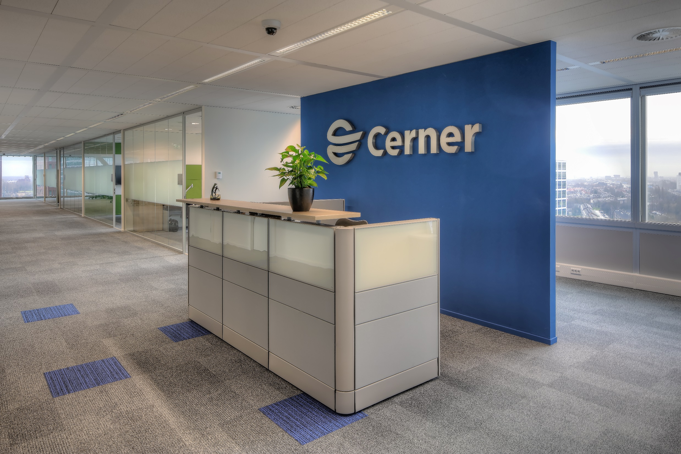

Wednesday 13 July
Visitors
Gunilla Lindgren (Cerner HR)
Notes:
7/12/2016
2

Slide 3
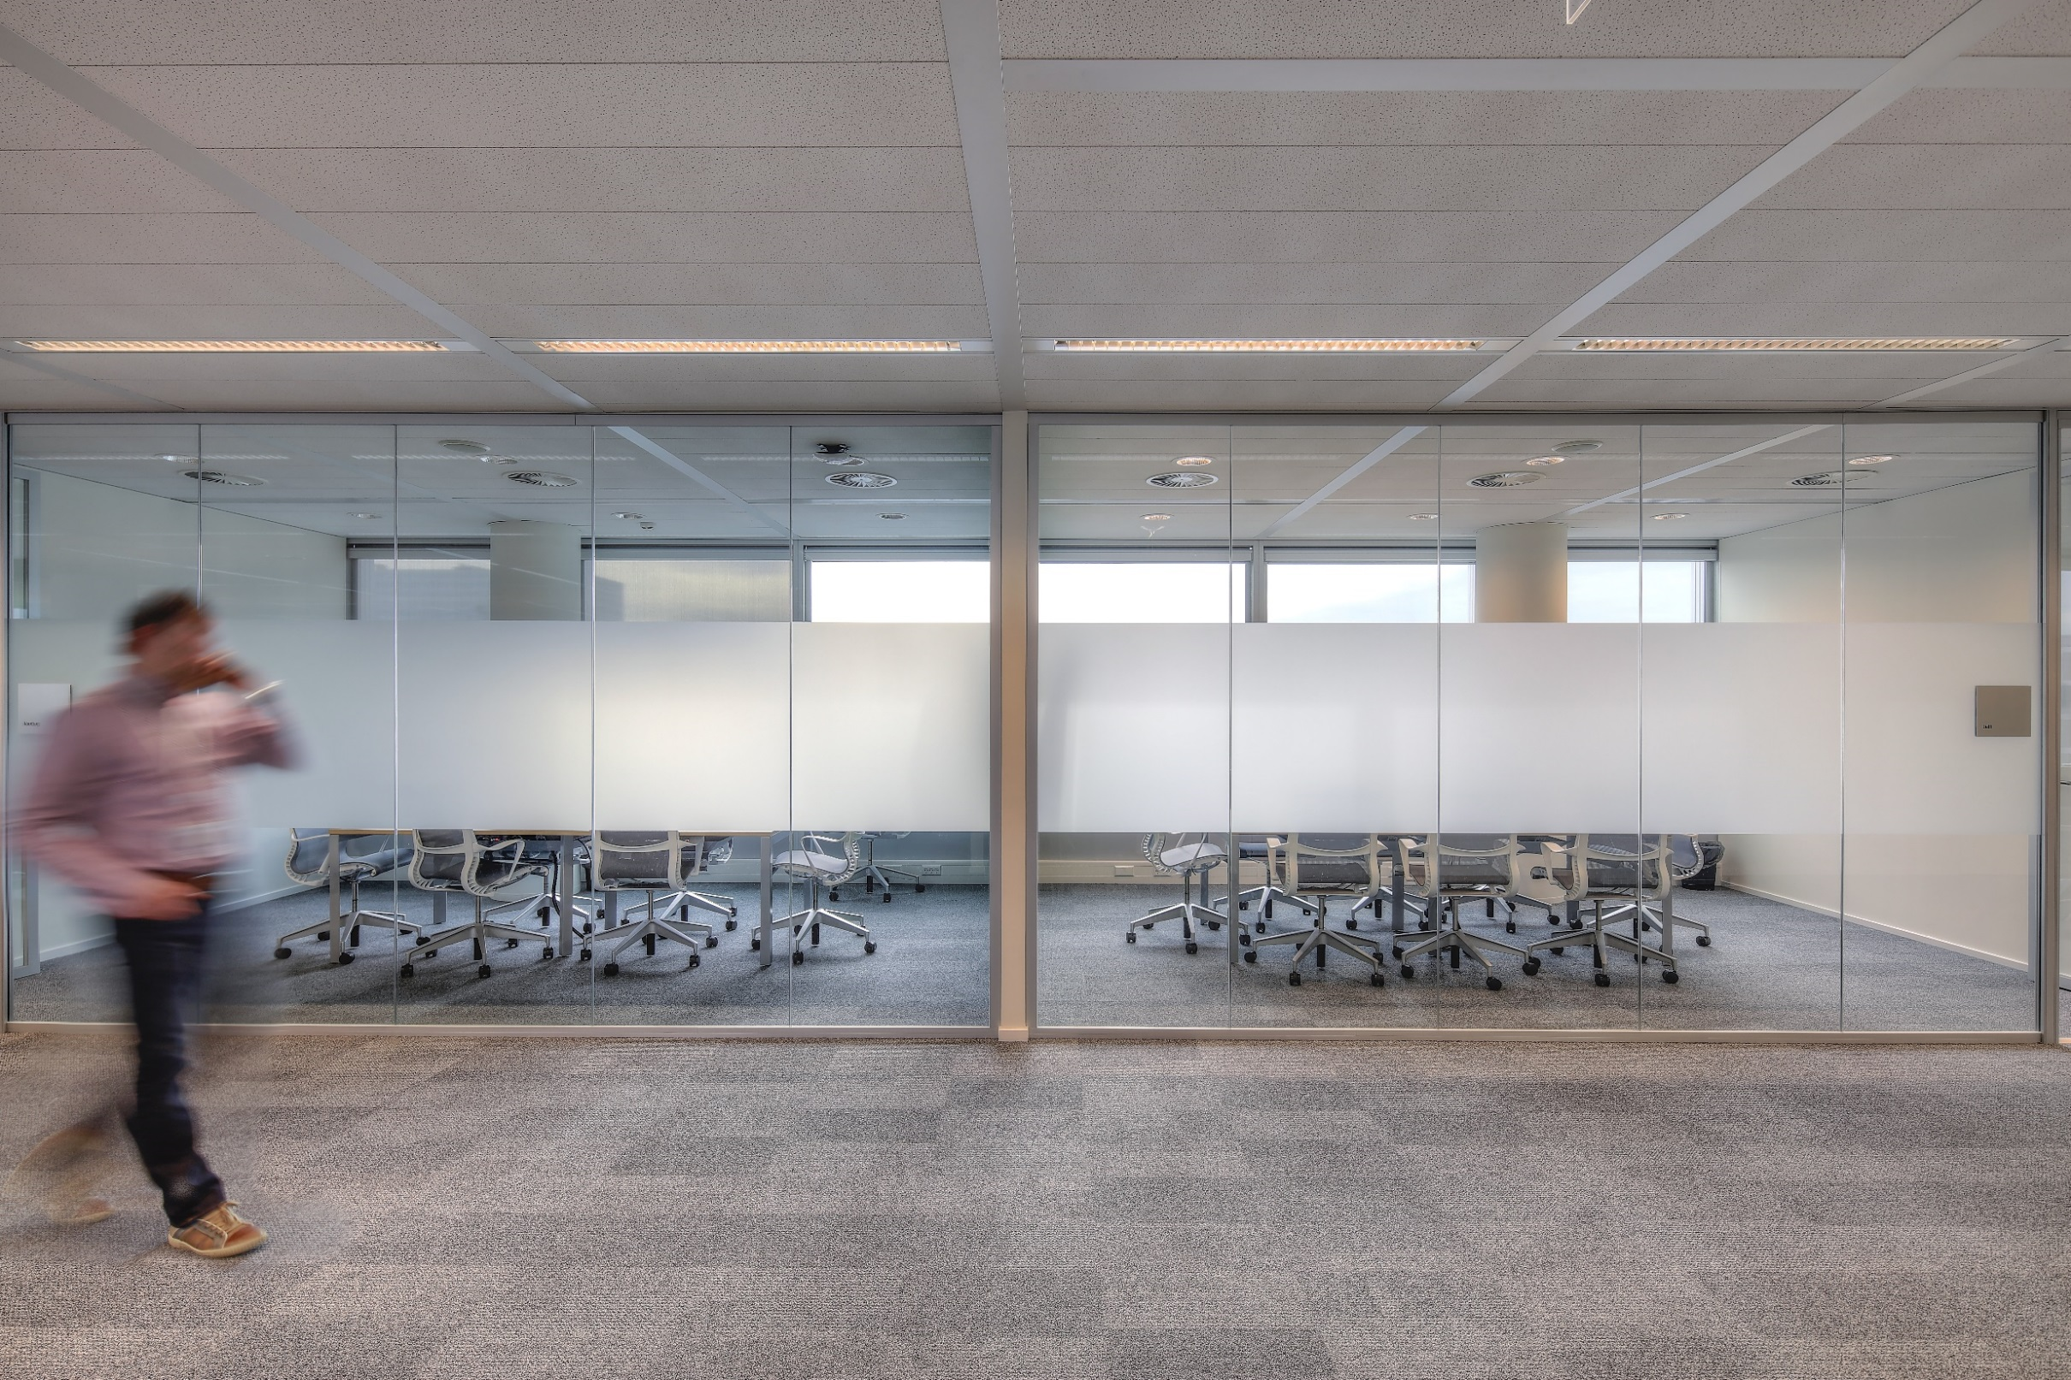
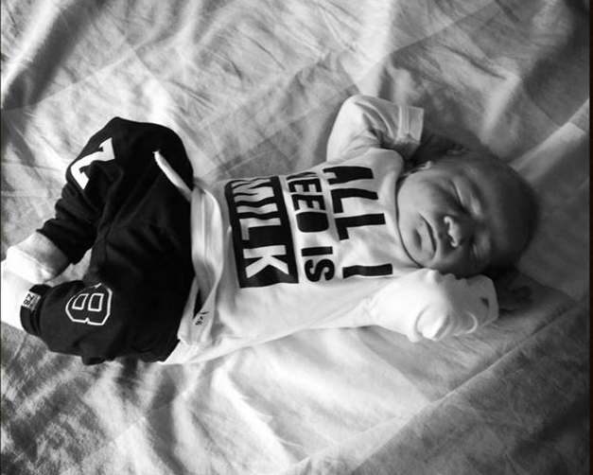

Wednesday 13 July
News
New Information Display (infoDisplay) Plugged into the network ? You can view in on: http://infodisplay.cerner.com/
Remco has become a proud father. Thomas den Ouden, 9/7/2016 ➔
Notes:
7/12/2016
3

Slide 4
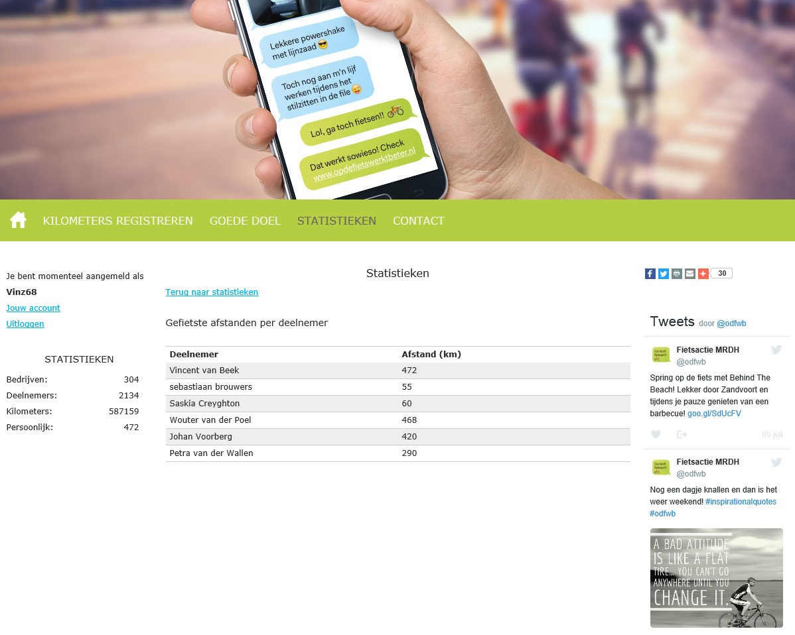

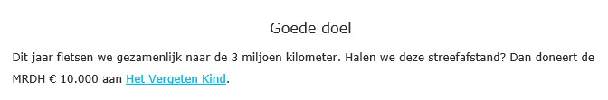
Wednesday 13 July
https://opdefietswerktbeter.nl/
Notes:
7/12/2016
4

Slide 5
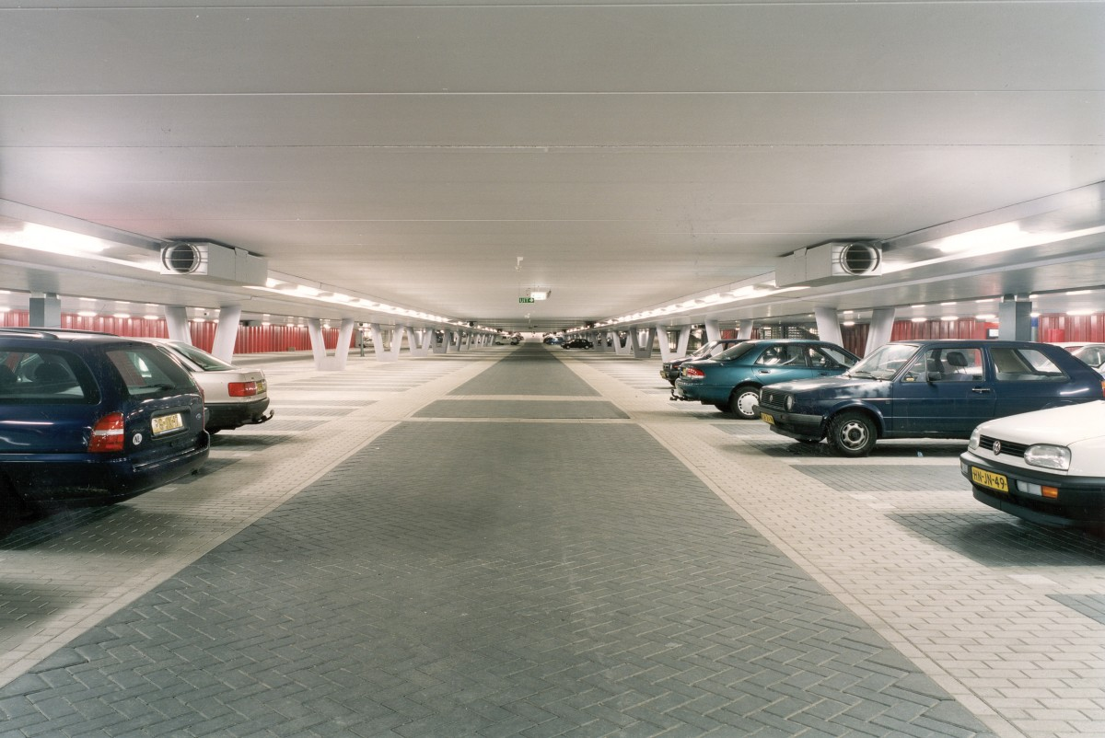

Wednesday 13 July Parking
-2/67
Michiel Janssen
-2/68
Vincent van Beek
-2/69
24
-2/70
Erik Tiggelaar
25
-2/71
26
-2/72
buiten
-2/73
buiten
Notes:
7/12/2016
5

